Slide 1
Compact Multi-Signatures for Smaller Blockchains
Dan Boneh (Stanford University)
Manu Drijvers (DFINITY)
Gregory Neven (DFINITY)
To appear at ASIACRYPT 2018

Slide 2
Bitcoin Transactions (P2PKH, simplified)
Tx1
input 1
input 2
…
output 1
output 2
…
Tx2
input 1
input 2
…
output 1
output 2
…

Slide 3
Bitcoin Transactions (P2PKH, simplified)
Tx1
input 1
input 2
…
H(pk₁), value₁
H(pk₂), value₂
…
Tx2
pointer, pk₁, s₁
pointer, pk₃, s₃
…
output 1
output 2
…

Slide 4
What multi-signatures can do for you
Compress signatures across inputs in a transaction
Tx1
input 1
input 2
…
H(pk₁), value₁
H(pk₂), value₂
…
Tx2
pointer, pk₁, s₁
…
pointer, pk_{inp}, s_{inp}
output 1
output 2
…
σ
1 group element
(pairings)
1 element +
1 exponent (DL)

Slide 5
What aggregate multi-signatures can do for you
… or across transactions in a block
Tx1
input 1
input 2
…
H(pk₁), value₁
H(pk₂), value₂
…
Σ
Tx2
pointer, pk₁, s₁
…
pointer, pk_{inp}, s_{inp}
output 1
output 2
…
…
Tx tx
1 group element (pairings)

Slide 6
Multisig address
H(n, t, pk₁,…,pk_{n})
Tx1
input 1
input 2
…
H(script), value
H(pk₂), value₂
…
Tx2
pointer, script, parameters
input 2
…
output 1
output 2
…
n, t, pk₁,…,pk_{n}
S, s₁,…,s_{t}

Slide 7
What multi-signatures can do for you
Compress public keys and signatures for n-out-of-n Multisig
H(n, n, apk)
Tx1
input 1
input 2
…
H(script), value
H(pk₂), value₂
…
Tx2
pointer, script, parameters
input 2
…
output 1
output 2
…
n, t=n, pk₁,…,pk_{n}
s₁,…,s_{n}
apk
σ
1 group
element
1 group element (pairings)
1 group element +
1 exponent (DL)

Slide 8
What aggregate multi-signatures can do for you
Further compress multi-signatures across inputs in a transaction
H(n, n, apk)
Tx1
input 1
input 2
…
H(script), value
H(pk₂), value₂
…
Tx2
pointer, script, parameters
…
input inp
output 1
output 2
…
n, t=n, pk₁,…,pk_{n}
s₁,…,s_{n}
apk
Σ
1 group element

Slide 9
What aggregate multi-signatures can do for you
..or even across transactions in a block
H(n, n, apk)
Tx 1
input 1
input 2
…
H(script), value
H(pk₂), value₂
…
Tx 2
pointer, script, parameters
input 2
…
output 1
output 2
…
Σ
n, n, pk₁,…,pk_{n}
s₁,…,s_{n}
apk
…
Tx tx
1 group
element

Slide 10
What accountable-subgroup multi-signatures can do
First fixed-size ASM for any n,t:
verify based on S plus 192 bytes
H(n, t, apk)
Tx1
input 1
input 2
…
H(script), value
H(pk₂), value₂
…
Tx2
pointer, script, parameters
input 2
…
output 1
output 2
…
n, t, pk₁,…,pk_{n}
S, s₁,…,s_{t}
apk
σ
1 group element
2 group elements

Slide 11
What partially aggregate ASM can do for you
Further (partially) compress signatures across inputs/txs
H(n, t, apk)
Tx 1
input 1
input 2
…
H(script), value
H(pk₂), value₂
…
Tx 2
pointer, script, parameters
input 2
…
output 1
output 2
…
Σ₁
n, t, pk₁,…,pk_{n}
S, s₁,…,s_{t}
apk
Σ₀
…
Tx tx
1 group element
1 group element

Slide 12
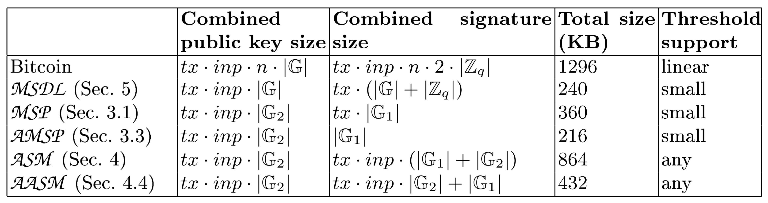
Witness size per block
tx = 1500 , inp = 3 , n = t = 3
Non-pairings curve secp256k1: |G| = |Z_{q}| = 32B
Pairings curve BLS381: |G₁| = 96B, |G₂| = 48B, |Z_{q}| = 32B

Slide 13
This talk
Background: Discrete logarithms and pairings
BLS signatures and rogue-key attacks
Secure multi-signatures with key aggregation
Accountable-subgroup multi-signatures
Conclusion

Slide 14
Background:
Discrete logarithms and pairings

Slide 15
Discrete logarithms and pairings
Discrete logarithms (DL) and computational Diffie-Hellman (CDH)
Group G of prime order q with generator P
DL: X → x : X = x∙P
CDH: A = a∙P, B = b∙P → C = ab∙P
Pairings and co-Computational Diffie-Hellman (co-CDH)
Pairing e : G₁ × G₂ → G_{T} , order |G₁| = |G₂| = |G_{T}| = q, generators P₁ , P₂ , P_{T}
Bilinearity: e(a∙P₁, b∙P₂) = e(P₁, P₂)^{ab} = e(b∙P₁, a∙P₂) = …
co-CDH: A = a∙P₁ , B₁ = b∙P₁ , B₂ = b∙P₂ → C = ab∙P₁
×
×
×

Slide 16
Discrete logarithms and pairings
Discrete logarithms (DL) and computational Diffie-Hellman (CDH)
Group G of prime order q with generator P
DL: X → x : X = x∙P
CDH: A = a∙P, B = b∙P → C = ab∙P
Pairings and Ψ-co-Computational Diffie-Hellman (Ψ-co-CDH)
Pairing e : G₁ × G₂ → G_{T} , order |G₁| = |G₂| = |G_{T}| = q, generators P₁ , P₂ , P_{T}
Bilinearity: e(a∙P₁, b∙P₂) = e(P₁, P₂)^{ab} = e(b∙P₁, a∙P₂) = …
Ψ-co-CDH: A = a∙P₁ , B₁ = b∙P₁ , B₂ = b∙P₂ → C = ab∙P₁
with access to oracle Ψ(x∙P₂) → x∙P₁
×
×
×

Slide 17
BLS signatures and rogue-key attacks

Slide 18
BLS signatures [Boneh-Lynn-Shacham 2001]
H : {0,1}* → G₂
KeyGen: sk ←_{R} Z_{q} , pk ← sk∙P₁
Sign: s ← sk∙H(m)
Verify: e(P₁, s) = e(pk, H(m))

Slide 19
Composing BLS signatures
[Boldyreva 2003]
[Boneh-GLS 2003]
s₁ = sk₁∙H(m₁)
…
s_{n} = sk_{n}∙H(m_{n})
σ ← Σ s_{i} = Σ sk_{i}∙H(m_{i})
Verification if m_{i} all different
e(P₁ , σ) = Π e(pk_{i} , H(m_{i}))
n+1 pairings
Verification if m_{i} all the same
e(P₁ , σ) = e( Σ pk_{i} , H(m))
2 pairings

Slide 20
Composing BLS signatures
[Boldyreva 2003]
[Boneh-GLS 2003]
s₁ = sk₁∙H(m₁)
…
s_{n} = sk_{n}∙H(m_{n})
σ ← Σ s_{i} = Σ sk_{i}∙H(m_{i})
×
Verification if m_{i} all different
e(P₁ , σ) = Π e(pk_{i} , H(m_{i}))
n+1 pairings
Secure under Ψ-co-CDH in the random-oracle model
Verification if m_{i} all the same
e(P₁ , σ) = e( Σ pk_{i} , H(m))
2 pairings
Insecure!

Slide 21
Rogue-key attacks
Verification if m_{i} all the same
e(P₁ , σ) = e( Σ pk_{i} , H(m))
Attack:
Given pk₁
Set pk₂ = sk₂∙P₁ – pk₁ ⇔ pk₁ + pk₂ = sk₂∙P₁
σ = sk₂∙H(m)
e(P₁ , σ) = e( pk₁+pk₂ , H(m) )
Possible fixes
Insist different messages: m_{i}’ = pk_{i} || m [Boneh-GLS 2003]
→ no key aggregation, less efficient verification
Include proof of knowledge/possession in public key
→ larger public keys
Smarter key aggregation
[Ristenpart-Yilek 2007]
[Bagherzandi-CJ 2008]

Slide 22
Secure multi-signatures with key aggregation

Slide 23
Multi-signatures from pairings (MSP)
Borrow key aggregation from MuSig for Schnorr [Maxwell-PSW 2018]
Key aggregation(pk₁,…,pk_{n})
a_{i} ← H₁(pk_{i} , {pk₁,…,pk_{n}}) for i=1,…,n
apk ← a₁∙pk₁ + … + a_{n}∙pk_{n}
Combine( (pk₁,σ₁), …, (pk_{n},σ_{n}) )
σ ← a₁∙s₁ + … + a_{n}∙s_{n}
Verify(apk, m, μ)
Check e(P₁, σ) = e(apk, H(m)) identical to standard BLS!

Slide 24
Multi-signatures from pairings (MSP)
Borrow key aggregation from MuSig for Schnorr [Maxwell-PSW 2018]
Key aggregation(pk₁,…,pk_{n})
a_{i} ← H₁(pk_{i} , {pk₁,…,pk_{n}}) for i=1,…,n
Optimization: apk ← 1∙pk₁ + a₂∙pk₁ + … + a_{n}∙pk_{n}
Combine( (pk₁,σ₁), …, (pk_{n},σ_{n}) )
σ ← a₁∙s₁ + … + a_{n}∙s_{n}
Verify(apk, m, μ)
Check e(P₁, σ) = e(apk, H(m)) identical to standard BLS!

Slide 25
Multi-signatures from pairings (MSP)
Borrow key aggregation from MuSig for Schnorr [Maxwell-PSW 2018]
Key aggregation(pk₁,…,pk_{n})
a_{i} ← H₁(pk_{i} , {pk₁,…,pk_{n}}) for i=1,…,n
Optimization: apk ← 1∙pk₁ + a₂∙pk₁ + … + a_{n}∙pk_{n}
Combine( (pk₁,σ₁), …, (pk_{n},σ_{n}) )
σ ← a₁∙s₁ + … + a_{n}∙s_{n}
Verify(apk, m, μ)
Check e(P₁, σ) = e(apk, H(m)) identical to standard BLS!
Theorem:
If co-CDH is hard in (G₁,G₂), then MSP is unforgeable in the random-oracle model.

Slide 26
Aggregate multi-signatures from pairings (AMSP)
Sign(sk_{i} , m)
s_{i} ← sk_{i} ∙ H(apk, m)
Aggregate( (apk₁, m₁, σ₁), …, (apk_{n}, m_{n}, σ_{n}) )
Σ ← σ₁ + … + σ_{n}
Verify ( (apk₁, m₁), …, (apk_{n}, m_{n}), Σ )
Check e(P₁, Σ) = Π e(apk_{i}, H(apk_{i},m_{i}))

Slide 27
Aggregate multi-signatures from pairings (AMSP)
Sign(sk_{i} , m)
s_{i} ← sk_{i} ∙ H(apk, m)
Aggregate( (apk₁, m₁, μ₁), …, (apk_{n}, m_{n}, μ_{n}) )
Σ ← σ₁ + … + σ_{n}
Verify ( (apk₁, m₁), …, (apk_{n}, m_{n}), Σ )
Check e(P₁, Σ) = Π e(apk_{i}, H(apk_{i},m_{i}))
Theorem:
If Ψ-co-CDH is hard in (G₁,G₂), then AMSP is unforgeable in the random-oracle model.

Slide 28
Interactive multi-signatures from DL (MSDL)
Fix of MuSig-1 [MaxwellPSW 2018 v1] after flaw in proof [Drijvers-EFN 2018]
Independently proposed as MuSig-2 [Maxwell-PSW 2018 v2]
Sign
3-round protocol à la [Bellare-Neven 2006]
Key aggregation
apk ← a₁∙pk₁ + … + a_{n}∙pk_{n} where a_{i} ← H₁(pk_{i}, {pk₁,…,pk_{n}})
Verify(apk, m, σ = (T, s))
c ← H(T, m)
Check s∙P = T + c∙apk identical to standard Schnorr!

Slide 29
Interactive multi-signatures from DL (MSDL)
Fix of MuSig-1 [MaxwellPSW 2018 v1] after flaw in proof [Drijvers-EFN 2018]
Independently proposed as MuSig-2 [Maxwell-PSW 2018 v2]
Sign
3-round protocol à la [Bellare-Neven 2006]
Key aggregation
apk ← a₁∙pk₁ + … + a_{n}∙pk_{n} where a_{i} ← H₁(pk_{i}, {pk₁,…,pk_{n}})
Verify(apk, m, σ = (T, s))
c ← H(T, m)
Check s∙P = T + c∙apk identical to standard Schnorr!
Theorem:
If DL is hard in G, then MSDL is unforgeable in the random-oracle model.

Slide 30
Accountable-subgroup multi-signatures

Slide 31

Brute-force t-out-of-n Multisig [Maxwell-PSW 2018]
Exhaustively list apk of all t-size subsets in Merkle tree
Works if $\left({n \atop t}\right)$reasonably small
root
root
H(script), value
pointer, script, parameters
apk_{i} , Merkle path
σ_{i}
apk₁ apk₂ apk₃ apk₄ apk₅ apk₆

Slide 32
Can we handle arbitrary t-out-of-n?
Yes! Using our accountable-subgroup multi-signature (ASM) scheme
Public key: apk ∈ G₁
Signature: subset S, (apk_{S} , σ) ∈ G₁ × G₂
One-round interactive setup
apk
H(script), value
pointer, script, parameters
apk
S, (apk_{S}, σ)
1 group element
log n bits +
2 group elements

Slide 33
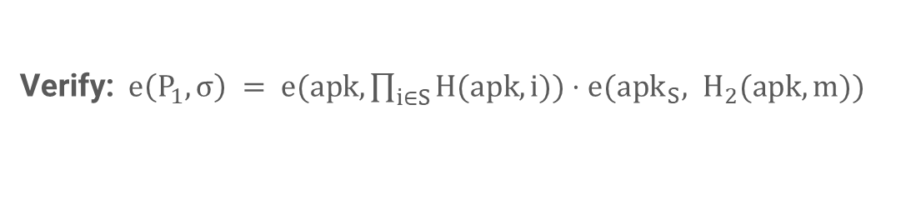
Our ASM scheme
Alice
pk₁ = sk₁∙P₁
Bob
pk₂ = sk₂∙P₁
Charlie
pk₃ = sk₃∙P₁
Key aggregation: apk ← a₁∙pk₁ + … + a₃∙pk₃ = ask∙P₁
Membership keys:
mk₁ = ask∙H(apk, 1)
mk₂ = ask∙H(apk, 2)
mk₃ = ask∙H(apk, 3)
Sign:
s₁ = mk₁ + sk₁∙H₂(apk,m)
s₂ = mk₂ + sk₂∙H₂(apk,m)
3 pairings
Combine: (apk_{{1,2}} , σ) = (pk₁+pk₂ , s₁+s₂)
Verify: $e\left(P_{1},σ\right) = e(apk, \prod_{i∈S}{H(apk,i))⋅e({apk}_{S}, H_{2}(apk,m))}$

Slide 34
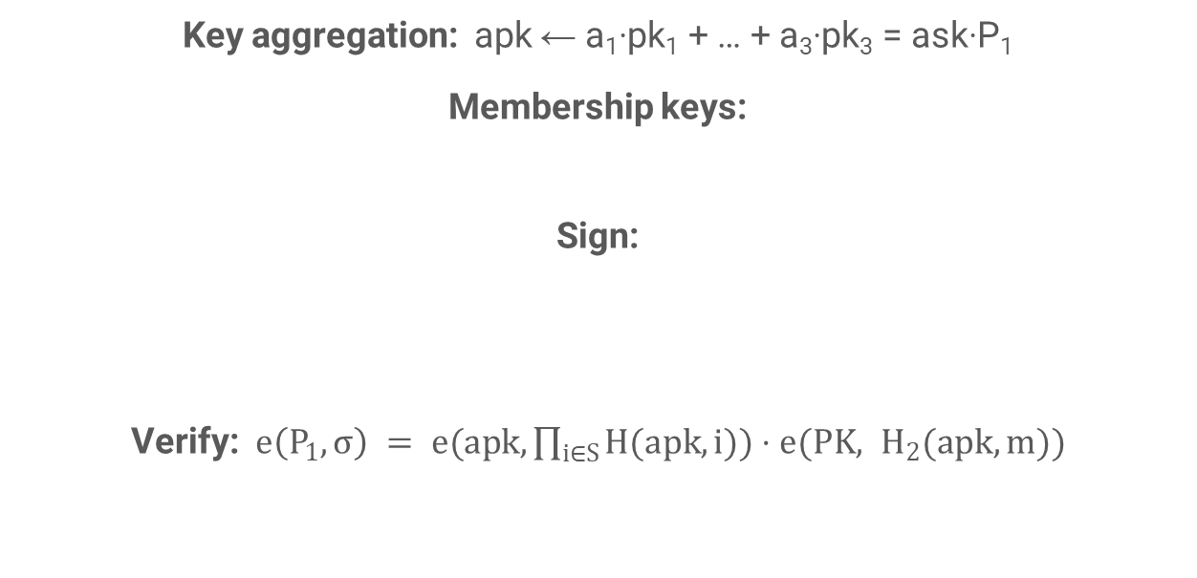
Our ASM scheme
Alice
pk₁ = sk₁∙P₁
Bob
pk₂ = sk₂∙P₁
Charlie
pk₃ = sk₃∙P₁
Theorem:
If Ψ-co-CDH is hard in (G₁,G₂), then ASMP is unforgeable in the random-oracle model.
Key aggregation: apk ← a₁∙pk₁ + … + a₃∙pk₃ = ask∙P₁
Membership keys:
Sign:
Verify: $e\left(P_{1},σ\right) = e(apk, \prod_{i∈S}{H(apk,i))⋅e(PK, H_{2}(apk,m))}$
mk₁ = ask∙H(apk, 1)
mk₂ = ask∙H(apk, 2)
mk₃ = ask∙H(apk, 3)
s₁ = mk₁ + sk₁∙H₂(apk,m)
s₂ = mk₂ + sk₂∙H₂(apk,m)
3 pairings
Combine: (apk_{{1,2}} , σ) = (pk₁+pk₂ , s₁+s₂)

Slide 35
The case for proofs of possession (PoPs)
Schnorr (MSDL)
KeyAgg ( (pk₁,T₁,s₁), …, (pk_{n},T_{n},s_{n}) ):
Check s_{i}∙P = T_{i} + H₃(T_{i},pk_{i})∙pk_{i} for all i
apk ← pk₁ + … + pk_{n}
BLS (MSP, AMSP, ASM)
KeyAgg ( (pk₁,s₁), …, (pk_{n},s_{n}) ):
Check e(P₁,s_{i}) = e(pk_{i}, H₃(pk_{i}))
apk ← pk₁ + … + pk_{n}
PoPs only exchanged among signers, do not go on chain!
Key aggregation simple sum of instead of n-multi-multiplication
→ huge efficiency gain for large n
Tighter security proofs

Slide 36
Conclusion

Slide 37
Conclusion
Savings in witness length when using our schemes
n-out-of-n Multisig address:
n ∙ 96B → 96B (MSDL) or 144B (MSP)
t-out-of-n Multisig address:
n ∙ 32B + t ∙ 64B → n/8 B + 192 B (ASM)
Multi-signing across inputs/transactions:
inp ∙ 96B → inp ∙ 32B + 64B (MSDL) or inp ∙ 48B + 92B (MSP)
tx ∙ inp ∙ 96B → tx ∙ inp ∙ 48B + 92B (AMSP)
Security proofs in ROM for all schemes
Hurdles for adoption?

Slide 38
Thank you!
https://eprint.iacr.org/2018/483

